Slide 1
Geo-locating Moving Platforms
PI: Alper Yilmaz
CoI: Ashish Gupta
The Ohio State University
OSU Award Number: GRT00030666
NGA Award Number: HM0210-13-1-0003
Notes:
1

Slide 2
Administrative Detail
Project Start: 6/3/2013
2+1 optional year
Initial 2 Year End Date: 6/2/2015
6 month extension request due to longer than usual hiring process for post-doc
Extended End Date: 12/2/2015
Two year budget: $263,031
Optional 3rd year budget: $134,994
2
Notes:
2

Slide 3
Timeline
1st year
Moving object detection and outlier rejection for moving cameras
2nd year
Scalable geo-localization
Vision-based trajectory generation
3rd year
GIS layers and landmark based navigation
Indoor + Outdoor navigation
UAV localization
3
Notes:
3

Slide 4
Contents
Current Work
Video Background Motion Compensation
3D Trajectory Estimation
Proposed Work
Geo-localization using Multiple Layers of GIS
Video Scene Parsing to Label GIS Layer Objects
Geo-Navigation using GIS
UAV Geo-localization and Accurate Relative Localization

Slide 5
Current Work
5
Notes:
5

Slide 6
Background motion estimation in video

Slide 7
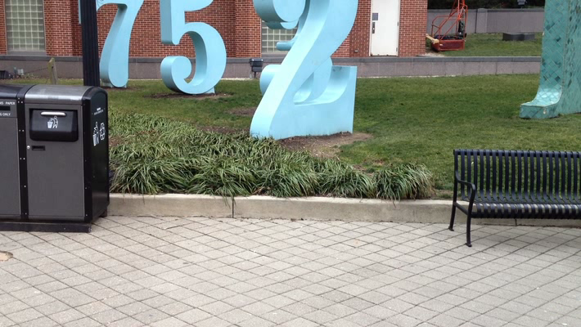
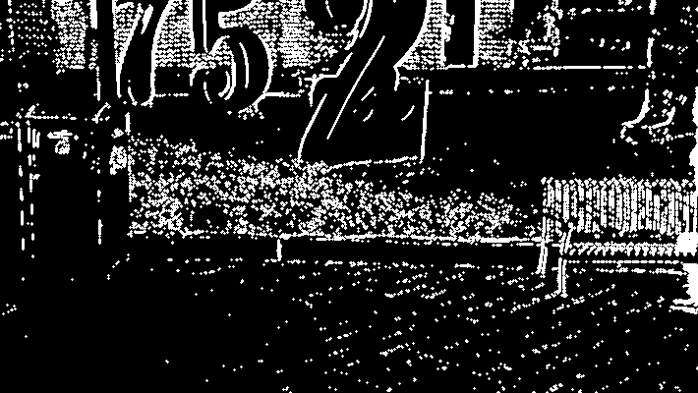
Prior Work Moving Object Detection
D. Zamalieva, A. Yilmaz and J. Davis. 2014. A Multi-Transformational Model for Background Subtraction with Moving Cameras. European Conf. on Computer Vision.
D. Zamalieva, A. Yilmaz and J. Davis. 2014. Exploiting Temporal Geometry for Moving Camera Background Subtraction. International Conf. on Pattern Recognition. Sweden
D. Zamalieva and A. Yilmaz. 2014. Background subtraction for the moving camera: A geometric approach. Computer Vision and Image Understanding, Vol 127, p. 73-85

Slide 8
Overview

Slide 9


Slide 11
Estimating 3D trajectory of mobile platform

Slide 12
Methodology
IMU data
Camera frames
IMU and Camera Calibration
Data Synchronization
Feature tracking
Initial State
Noise and Filter Parameters
State and covariance propagation
Triangulation
Kalman filter
Camera pose

Slide 13
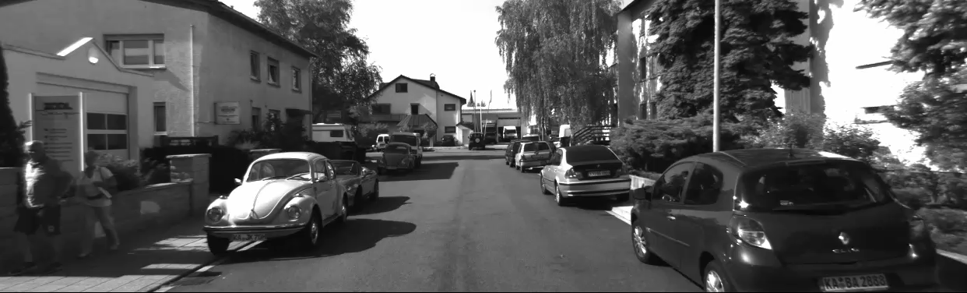
Mobile platform camera view

Slide 14
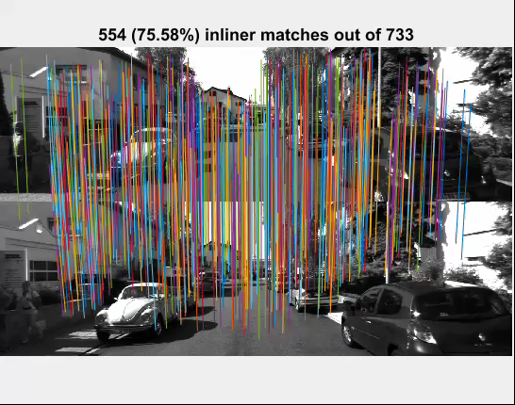
DSP Sift based correspondences

Slide 15
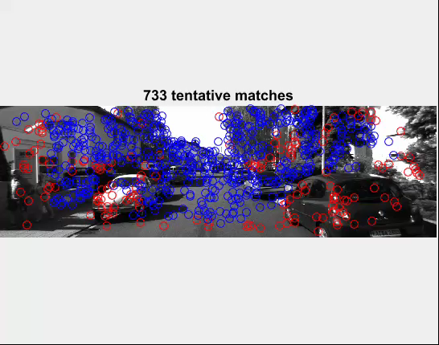
Geometric Inlier Outlier Sets

Slide 16
Evaluation of 3D trajectory

Slide 17
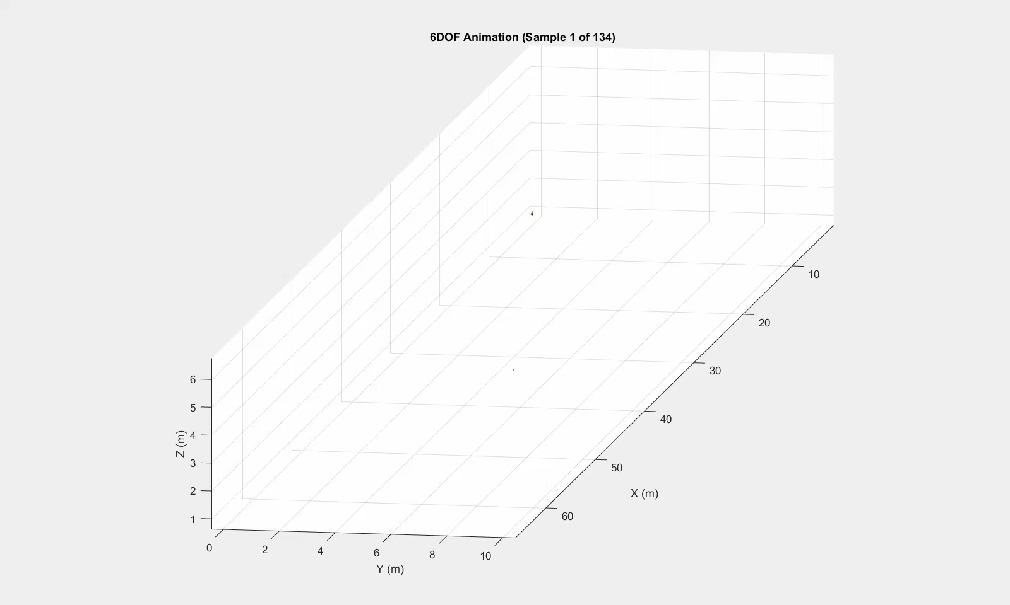
Recovered 3D Trajectory

Slide 18
Geo-Navigation using GIS

Slide 19
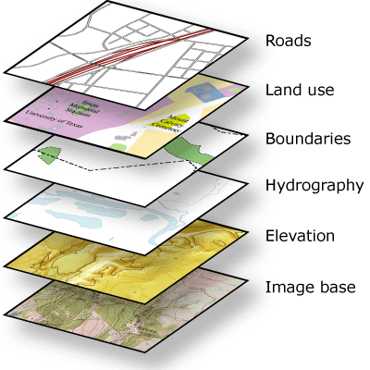
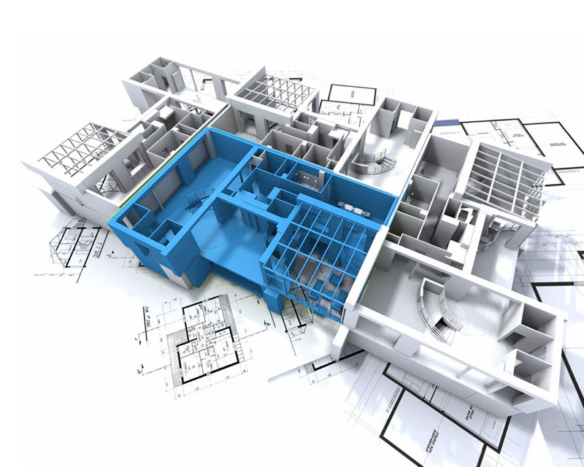
Navigation
GPS
GPS-Denied
Alternate Sensors
Visual
IMU
Sonar
UWB
Geographic Information System
Building Information Model
Notes:
Relative position. Mobile platform refers to hand held camera on automobile, UAV, boats

Slide 20
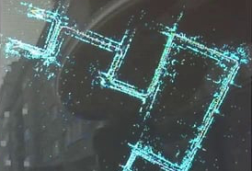
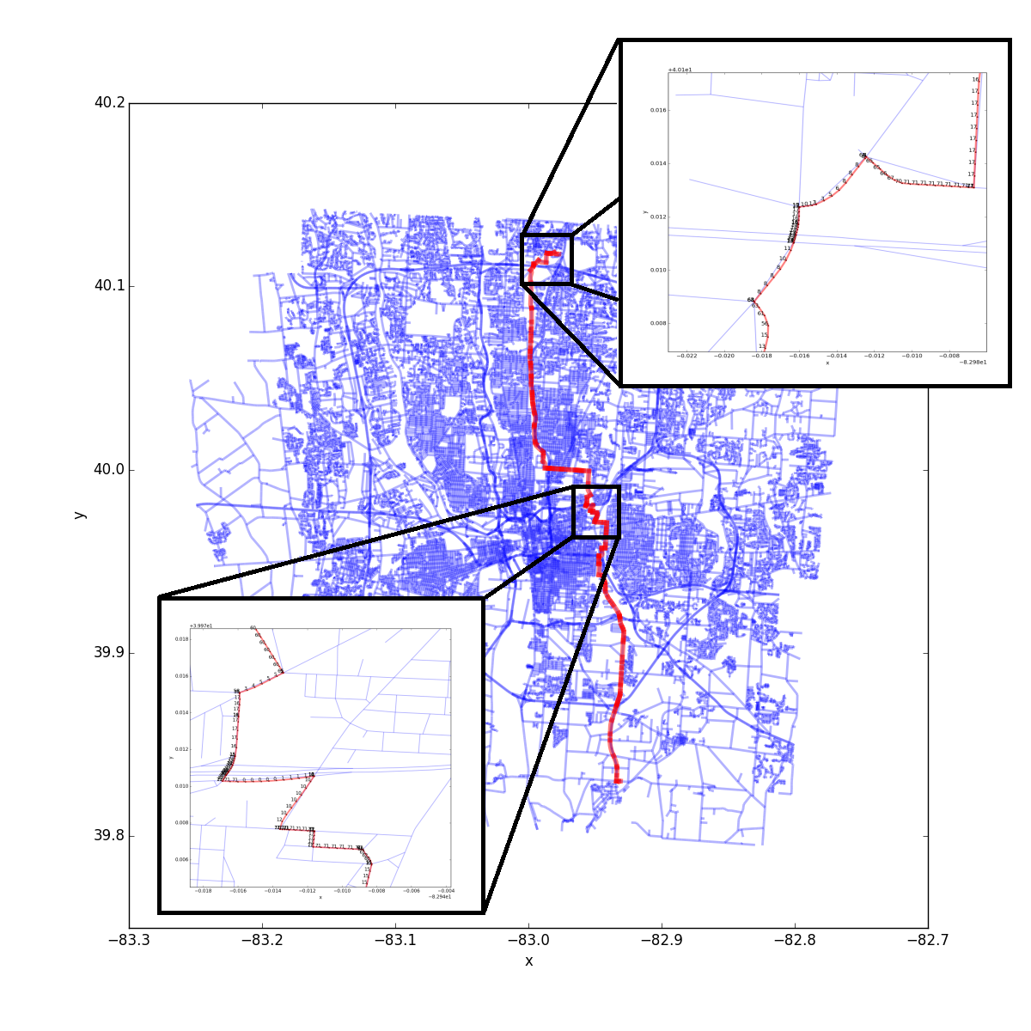
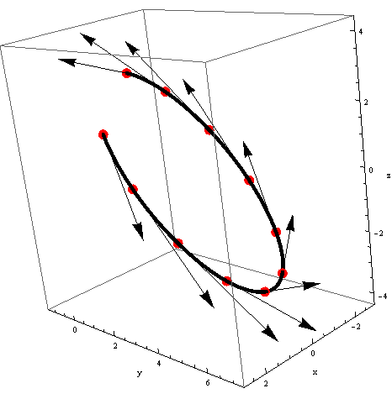
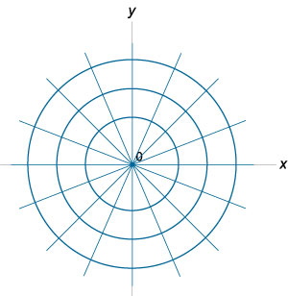
Encoding Trajectories
Graph-edges (Road) descriptors along a trajectory
Encode trajectory in quantized polar coordinates

Slide 21
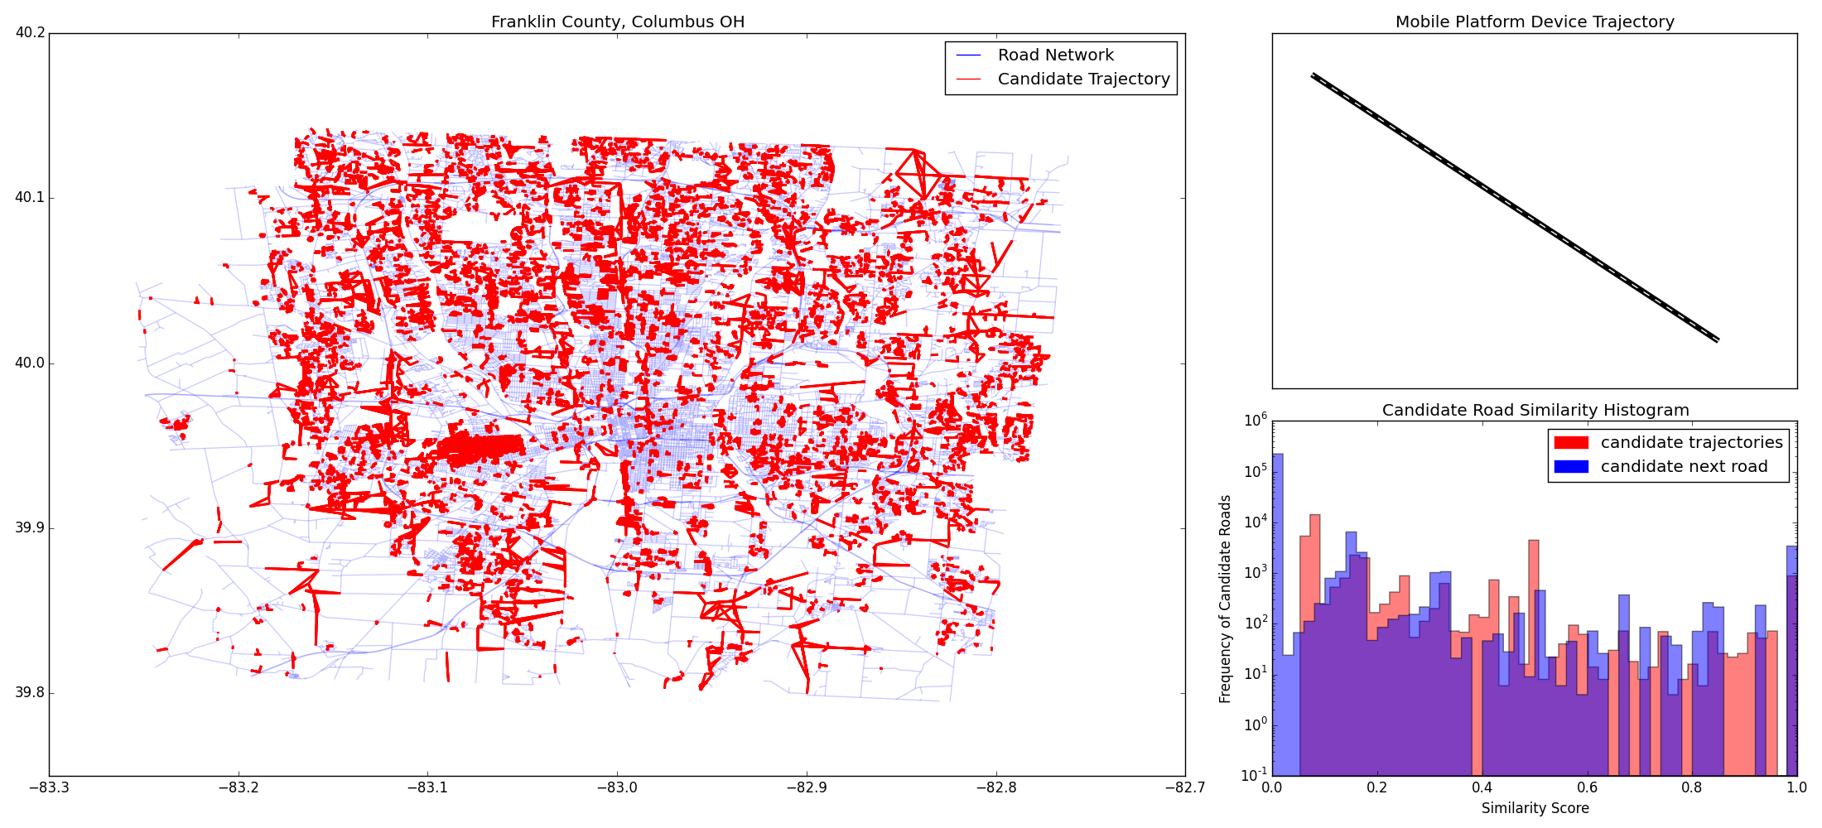
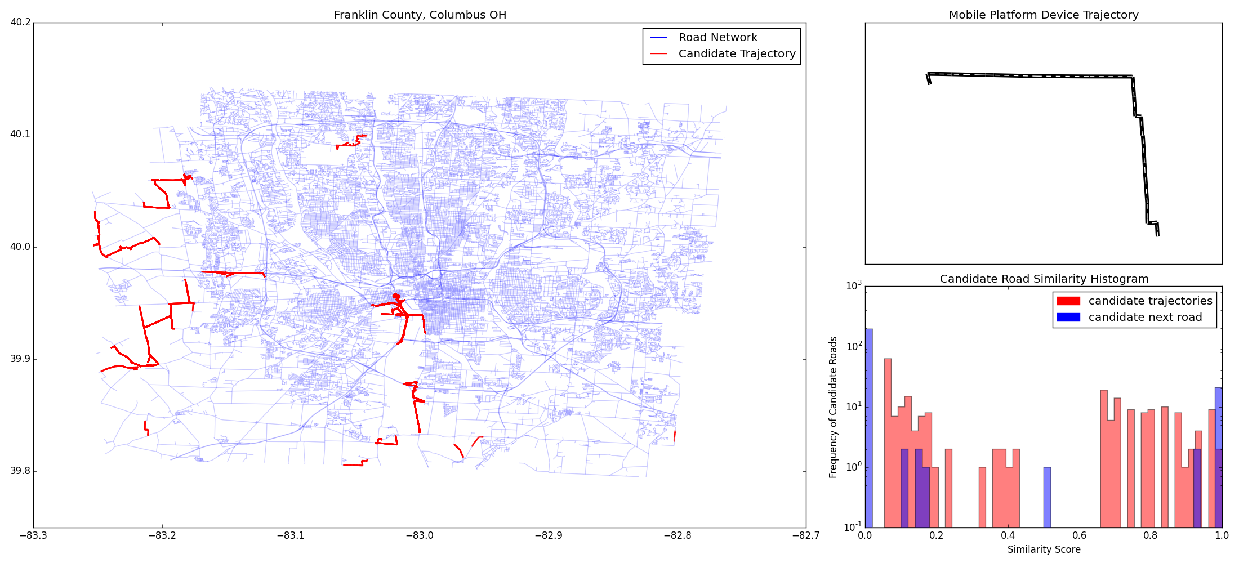
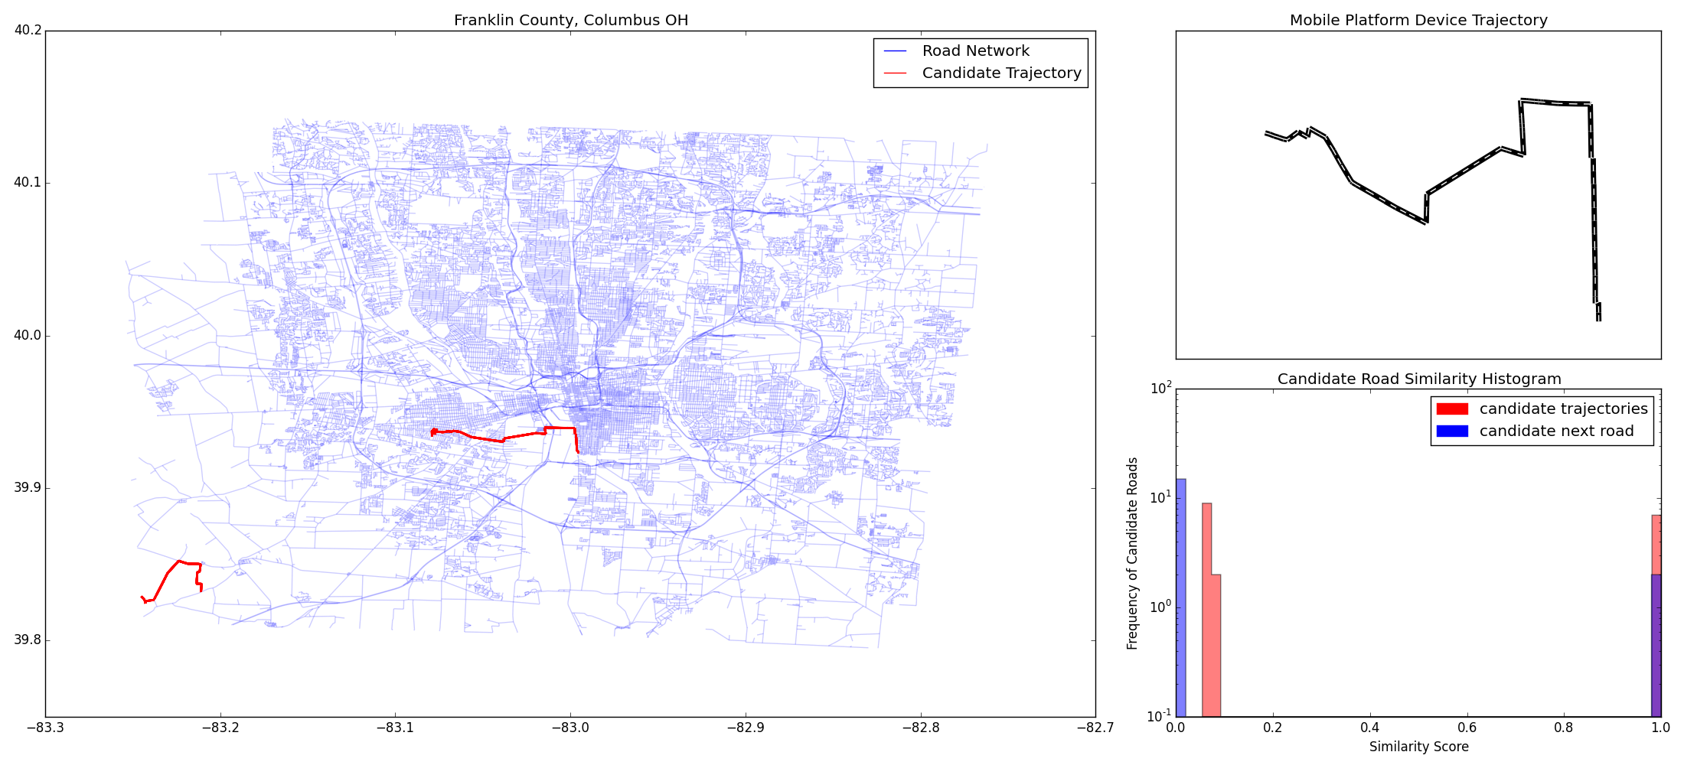
Progressive localization
Predicting
trajectory

Slide 22
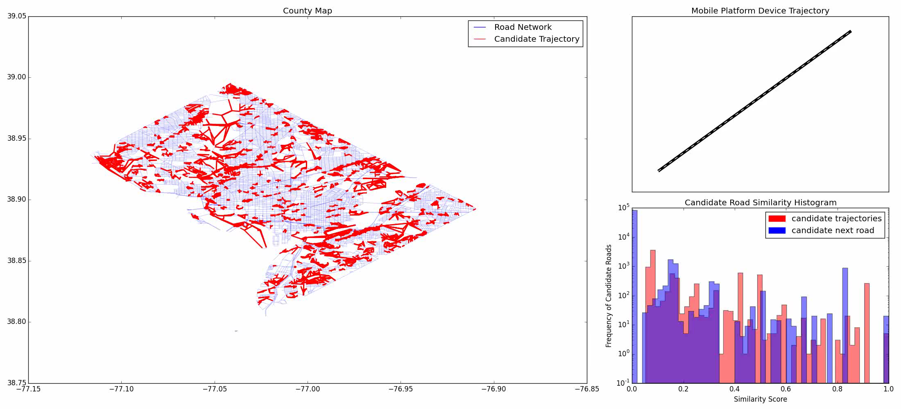
Trajectory Localization, Washington DC
Washington DC
Graph with 14K nodes and 20K edges
Roads are mostly regular lattice structured urban.

Slide 23
Trajectory Localization, Montpellier France
Map of Montpellier, France
Graph with 104K nodes and 137K edges
Urban and rural roads with fibrous structure

Slide 24
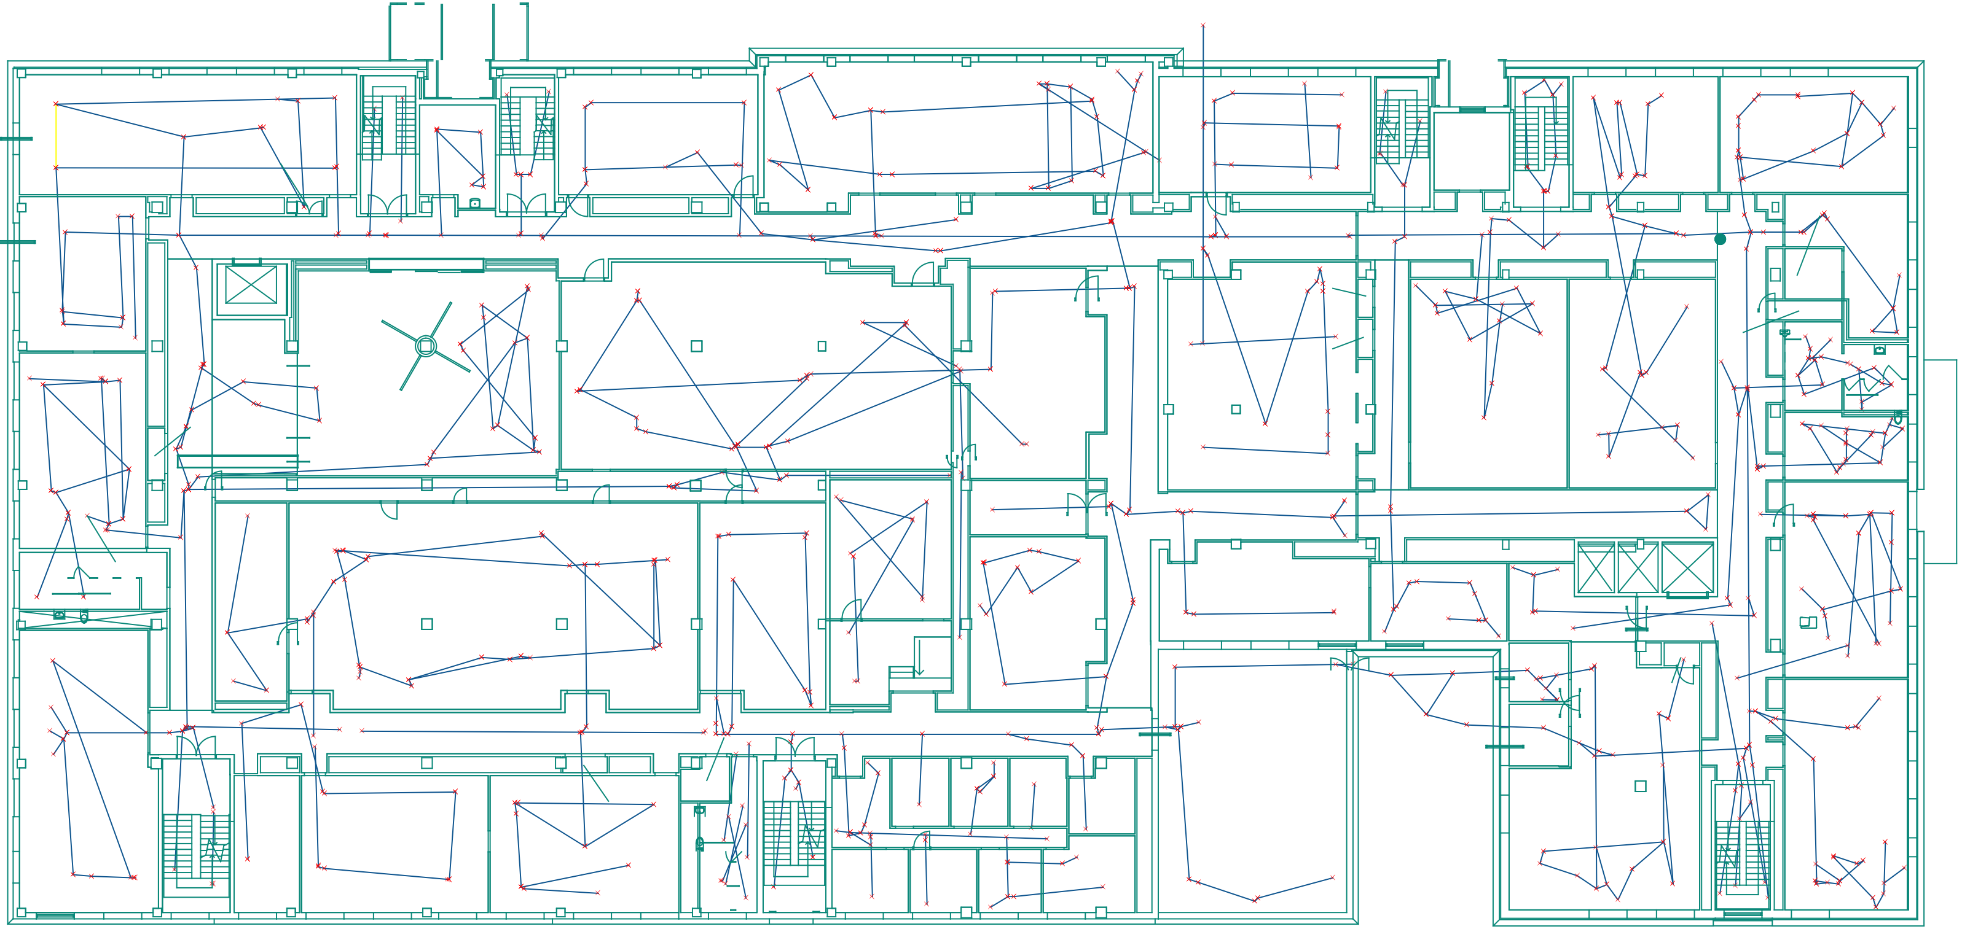
Extension to Indoor Navigation
Indoor modeled using trafficable routes
Architectural elements, furniture, utility objects create different traffic routes.
24
Notes:
24

Slide 25
Extension to Indoor Navigation
Smith Lab 2nd floor, OSU
Modeled using 600 nodes and 350 edges
Routes shapes are related to room organization, and location of obstacles and other objects

Slide 26
Proposed Work
26
Notes:
26

Slide 27
Geo-Localization using Multiple GIS Layers

Slide 28
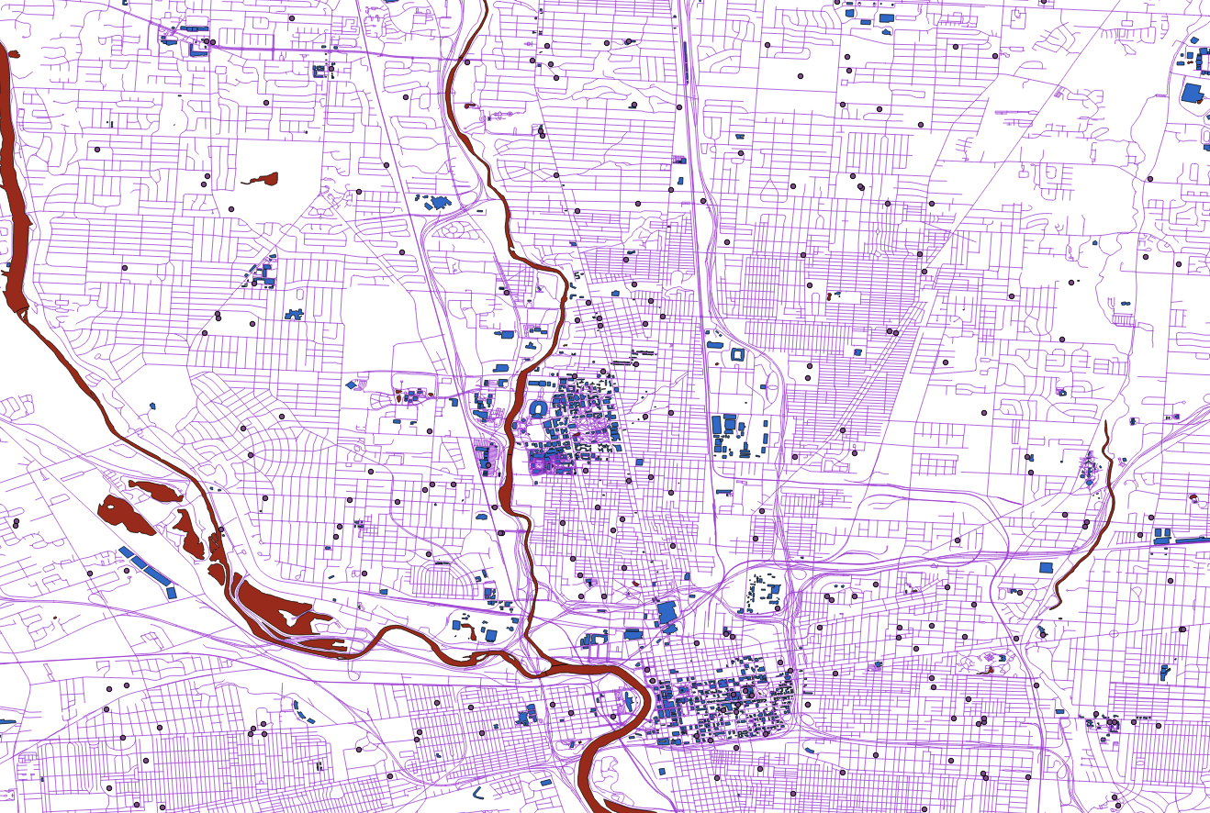
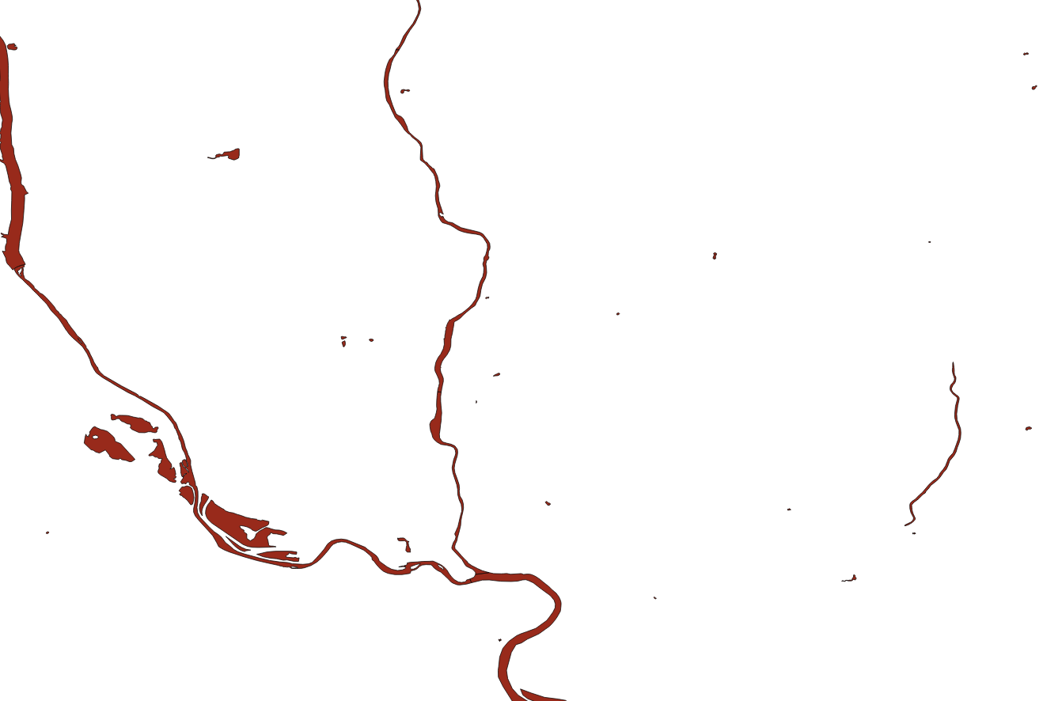

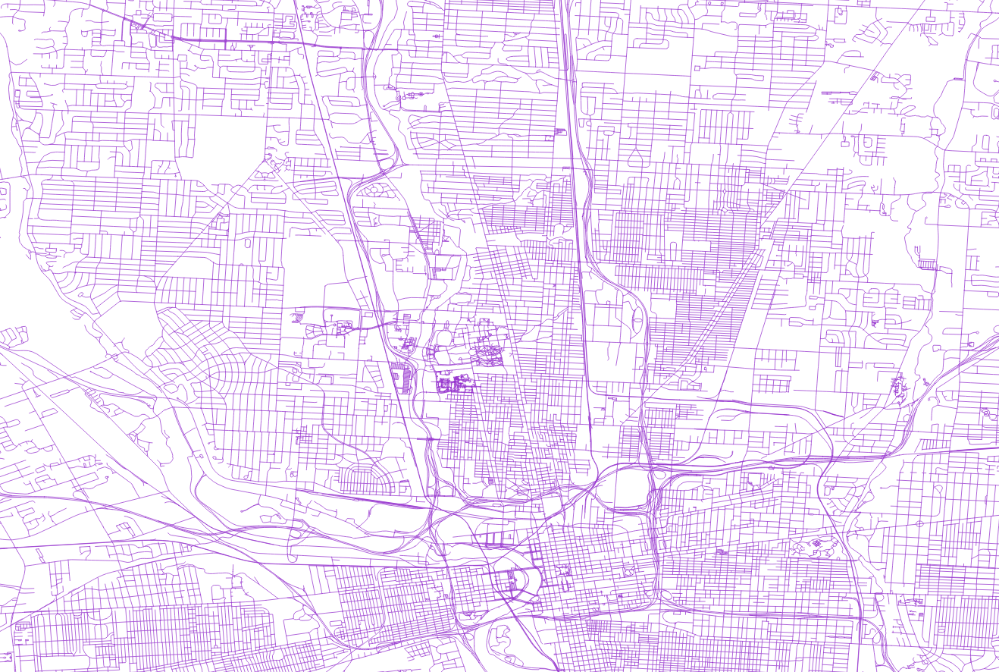
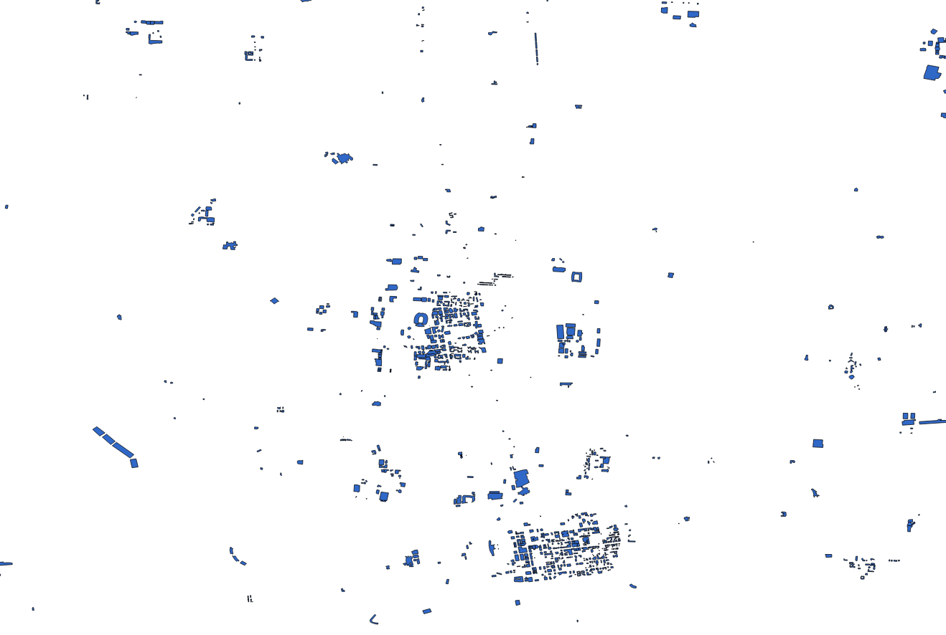
GIS Layers
waterways
amenities
roads
Each GIS layer has different visual content in camera view
buildings
28
Notes:
28

Slide 29
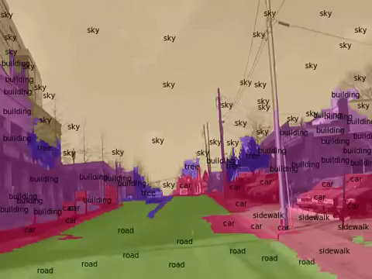
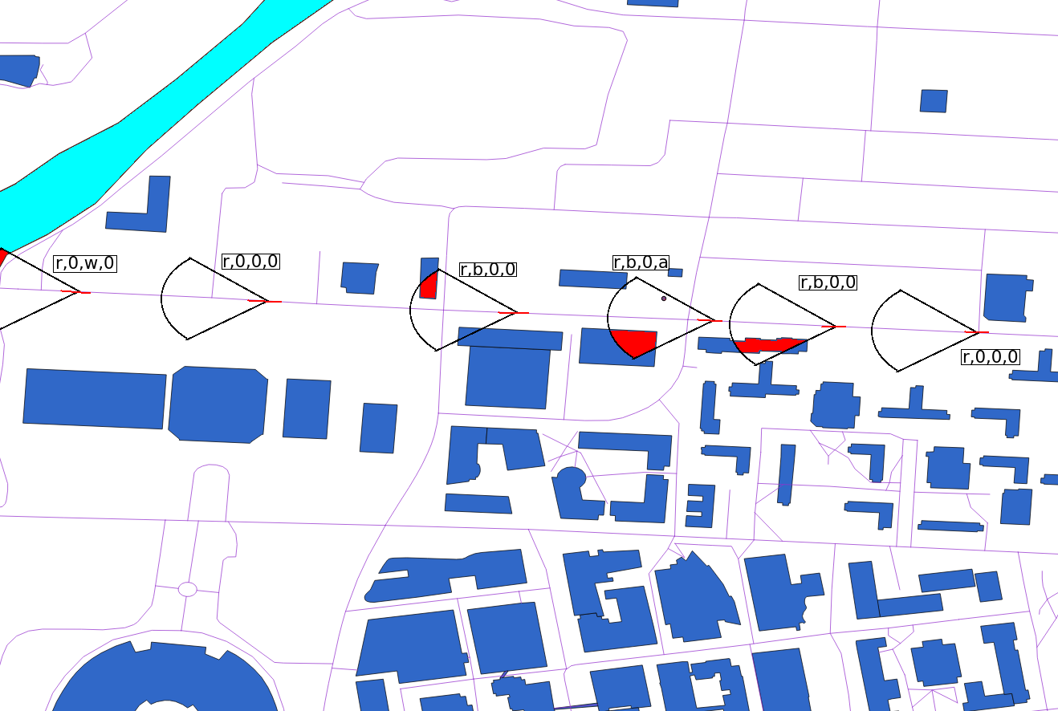
Video frame classification
Visual object recognition will be used to classify GIS layer objects in camera view
Trajectory descriptor is augmented with labels of objects in each GIS layer
29
Notes:
29

Slide 30
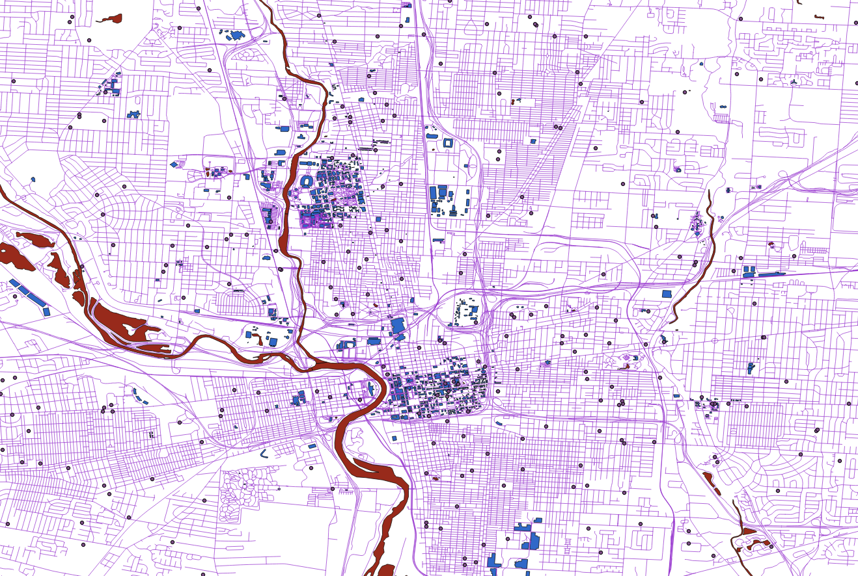
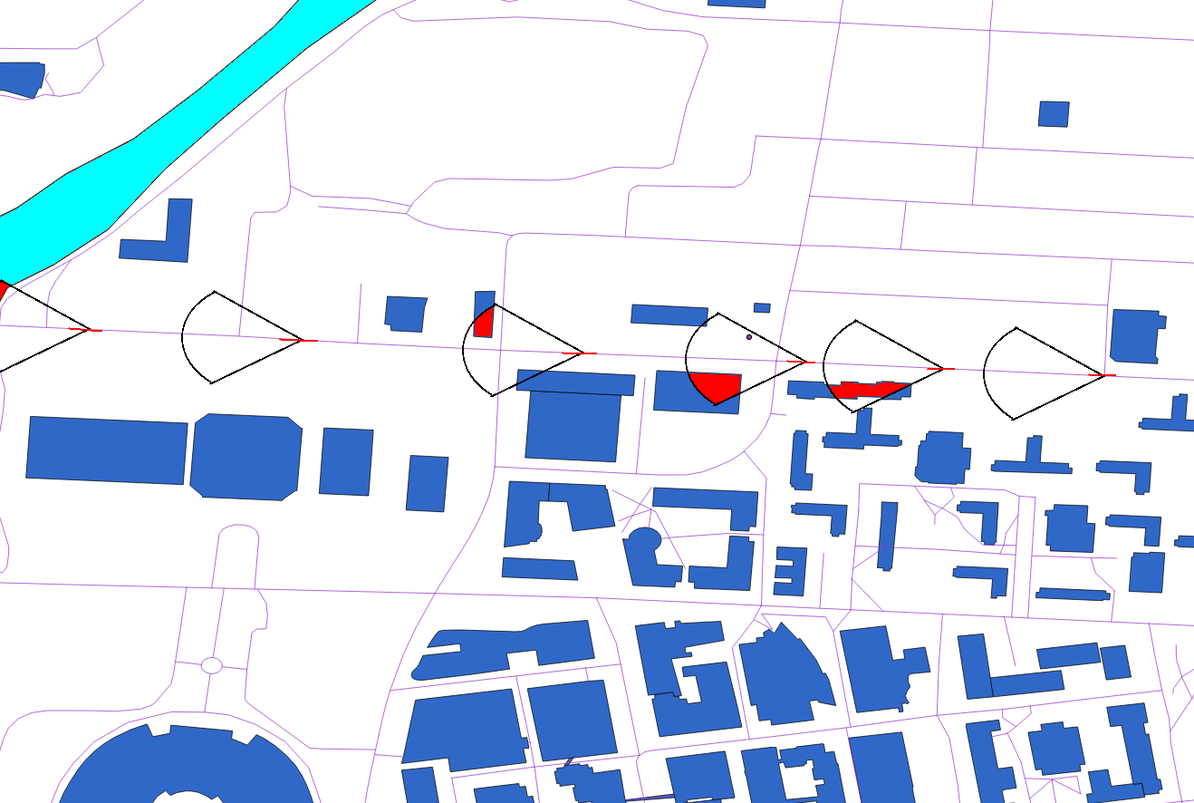
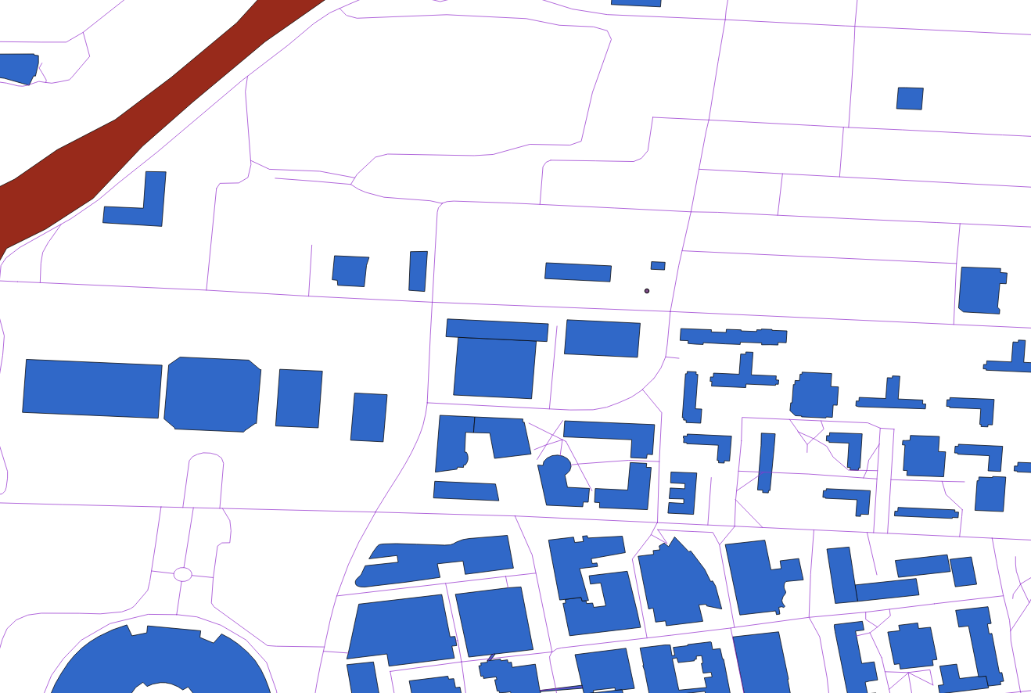
Trajectory in multiple GIS Layers
Elements of each GIS layer, in view of camera (sensor) are encoded to augment the trajectory.
30
Notes:
30

Slide 31
Geo-Localization of UAV

Slide 32
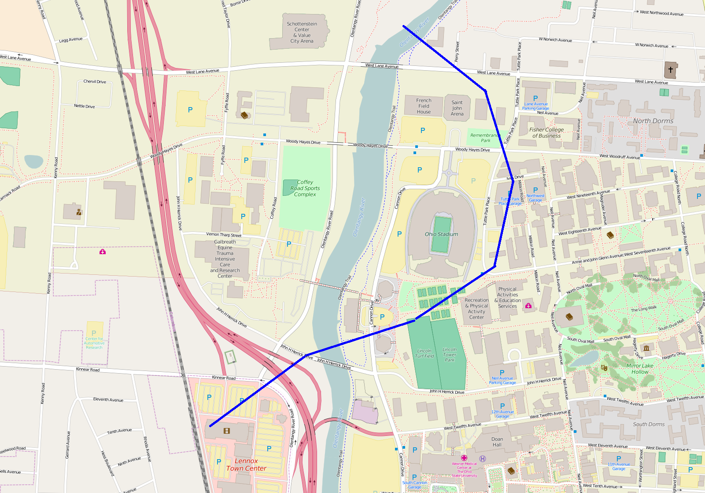
UAV trajectory
The trajectory of a land vehicle like car is correlated to the GIS transport layer, but a UAV is not similarly constrained.

Slide 33
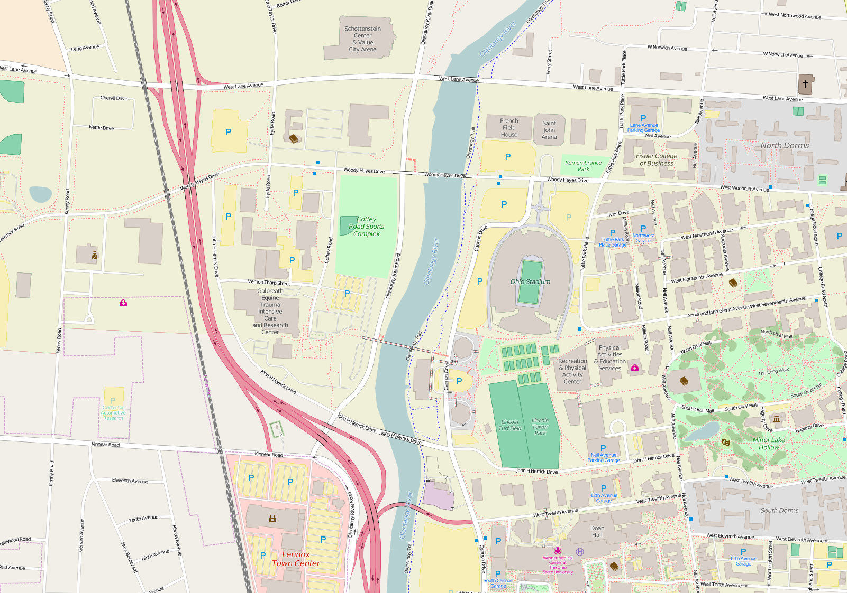
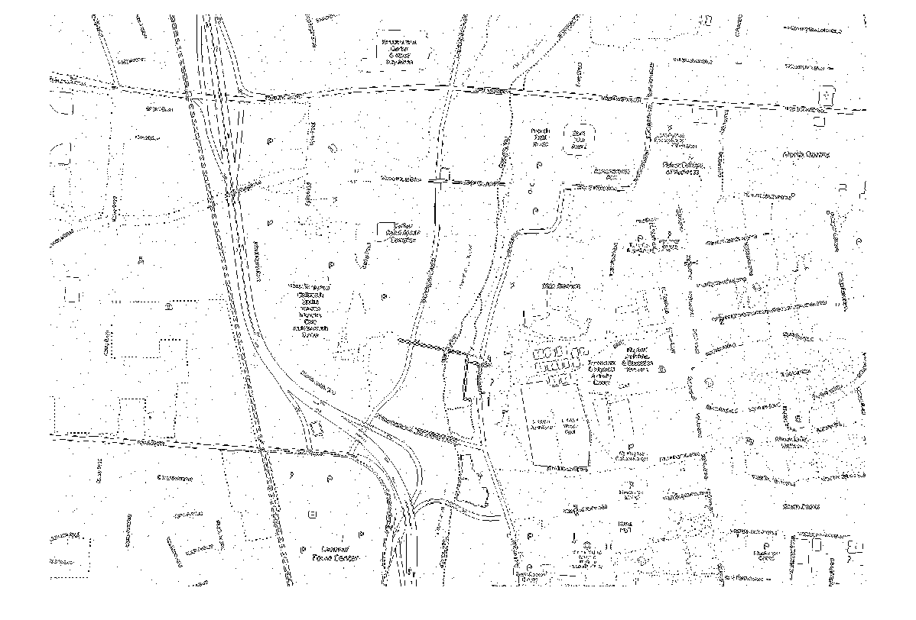
Low-level Image Features
GIS layers map (Columbus, OH)
Visual Features in GIS layers

Slide 34
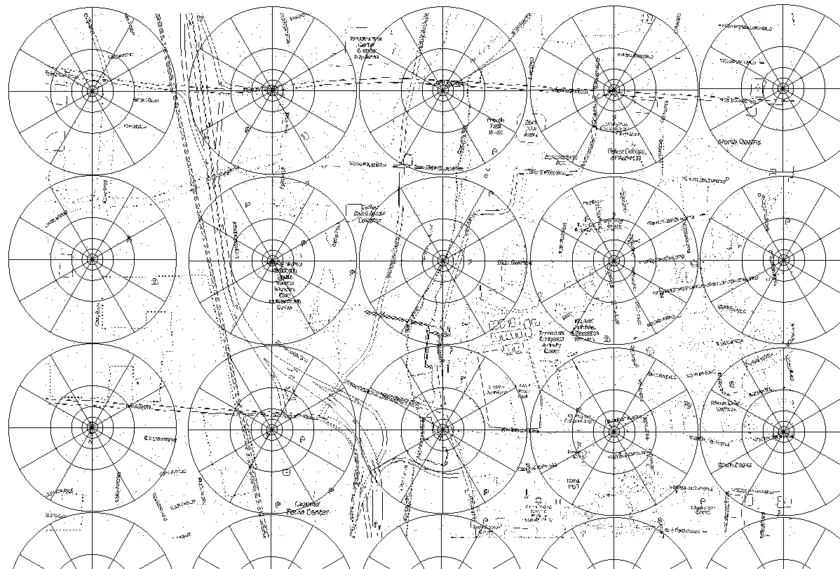
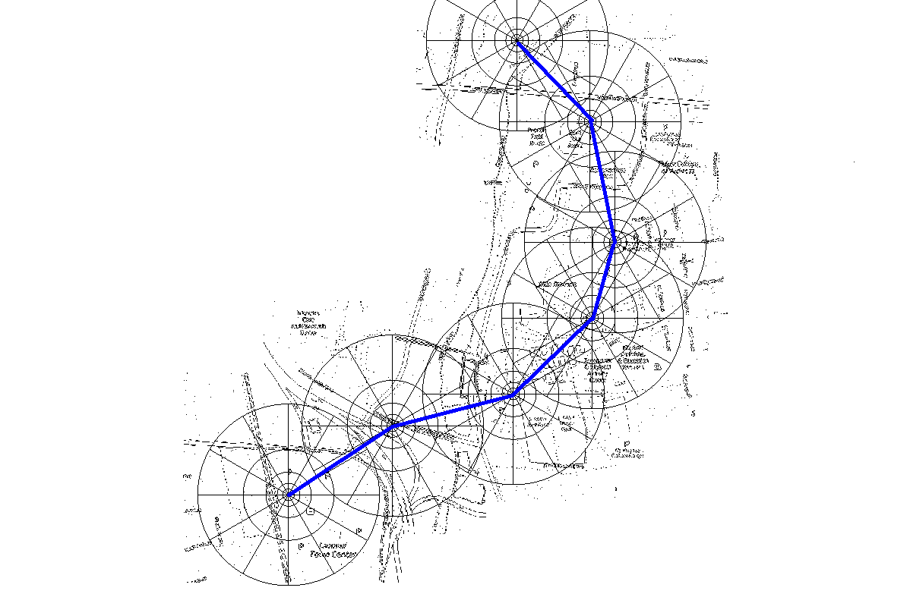
GIS and UAV Trajectory Representation
Low-level Features of GIS Layers are encoded using a spatial contextual descriptor
Ground-plane Features of UAV images are encoded using same contextual descriptor

Slide 35
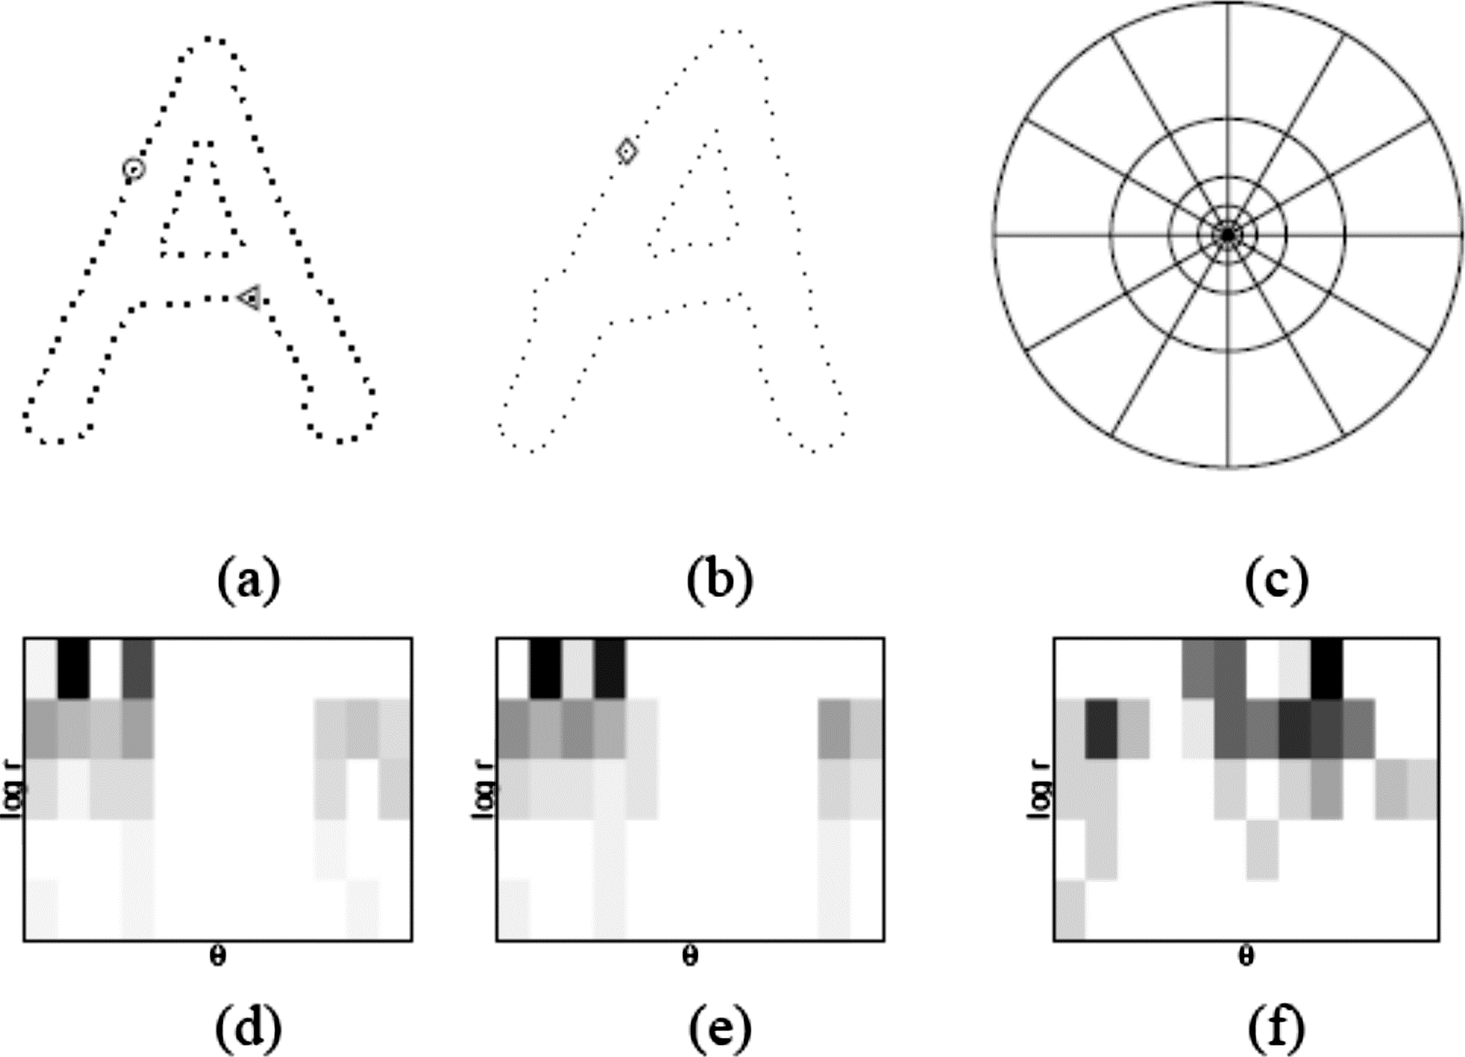
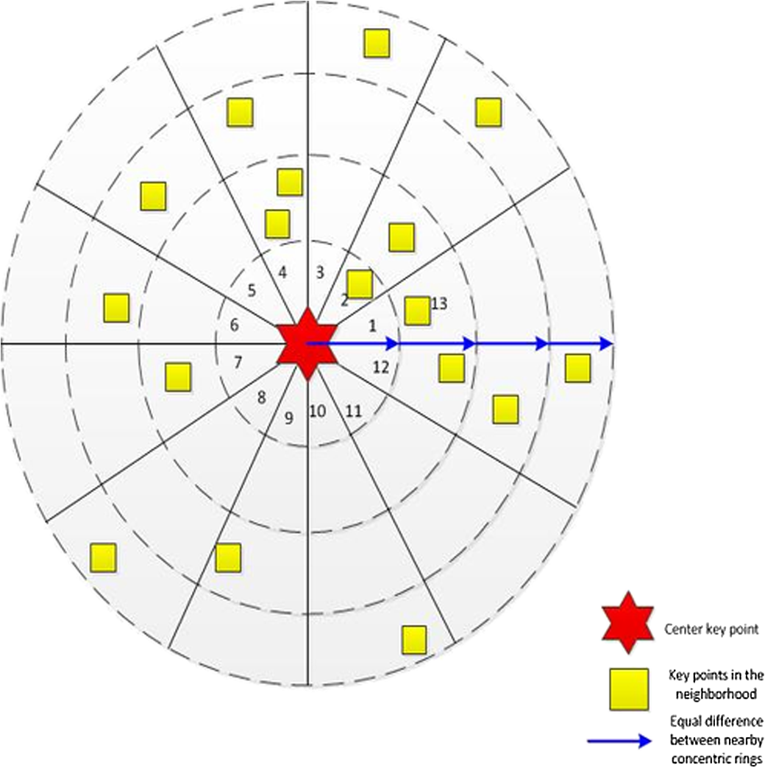
Spatial Contextual Descriptor
Shape-Context Descriptor
Log-polar accumulator centered on each feature point in the map and image generates a histogram of local feature-point distribution.
Comparison of histograms can be modified to be robust to noise and missing data issues when matching UAV trajectory to GIS map.

Slide 36
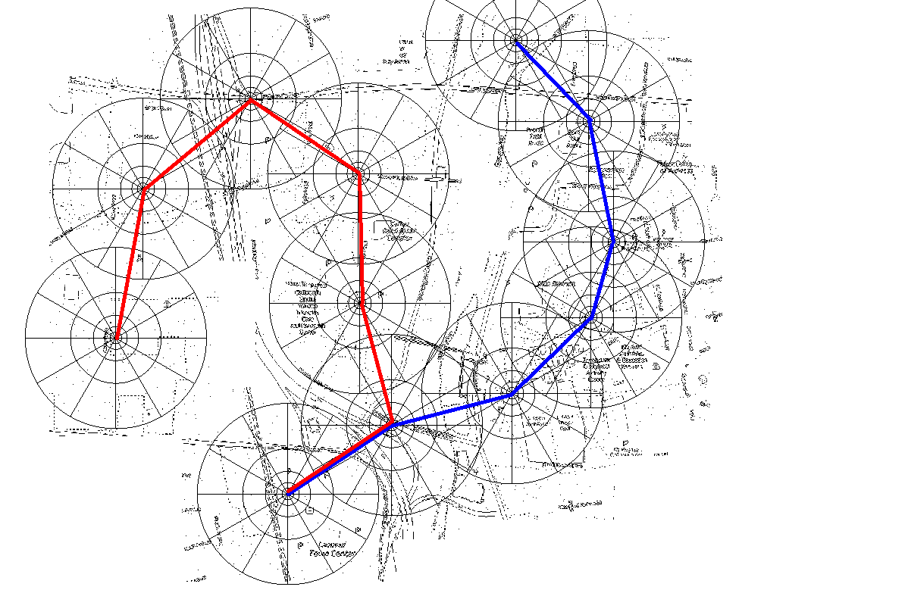
Distinguishing UAV Trajectories
T₁ = [d₁₁, d₁₂, d₁₃, d₁₄, d₁₅, d₁₆, d₁₇]
T₂ = [d₂₁, d₂₂, d₂₃, d₂₄, d₂₅, d₂₆, d₂₇]
D(T₁, T₂) ~ L([T])
Difference between trajectories increases with distance travelled by UAV

Slide 37
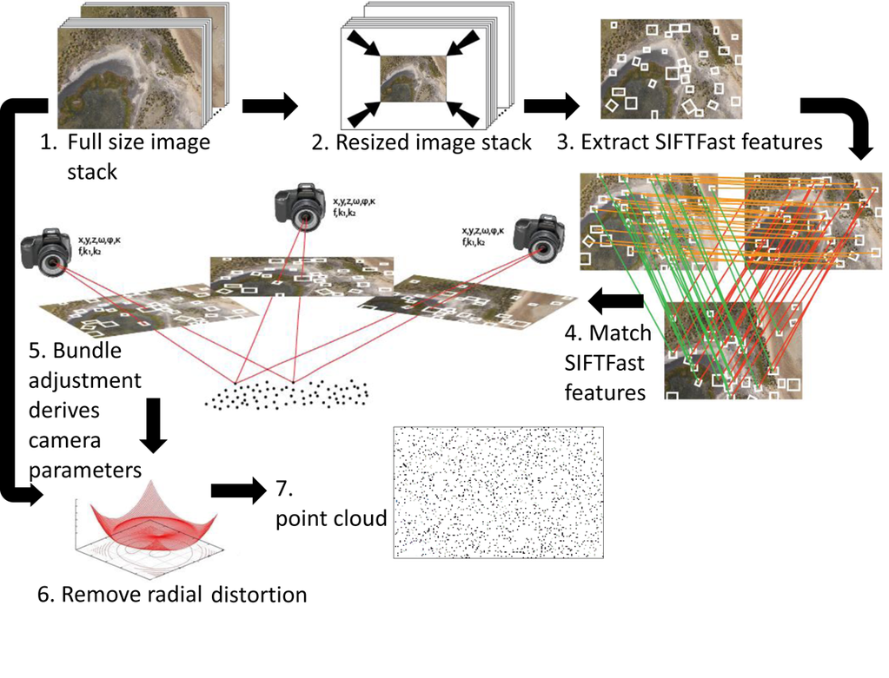
UAV images feature point generation

Slide 38
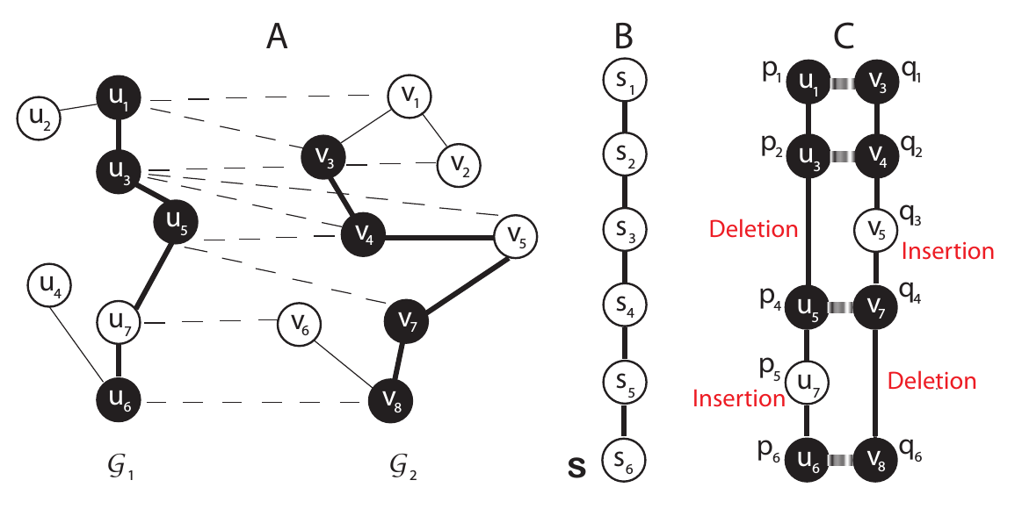
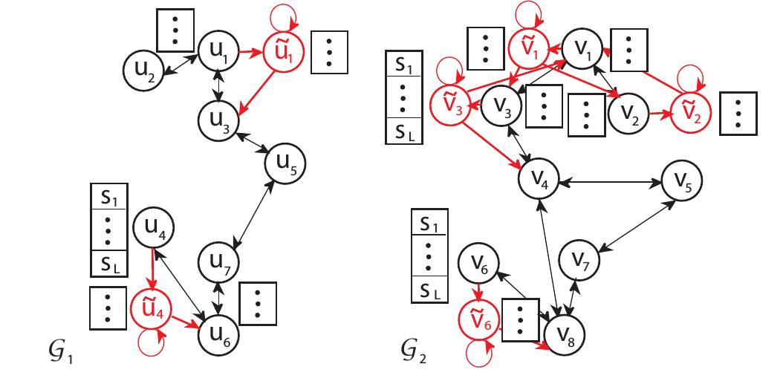
Hidden-Markov-Model based UAV trajectory search as graph matching
Two trajectories (sub-graphs G₁ and G₂) can be compared by pair-wise node matching.
The approach can be modified to handle missing nodes and insert nodes if required to handle missing data.
Hidden-Markov Models provide a probabilistic framework to model the trajectory and matching with ‘ground truth’ GIS layers map.
HMMs are robust to noise and missing data (had popular in conceptually similar and challenging tasks like handwriting and voice stream matching)

Slide 39
Accurate Localization of UAV

Slide 40
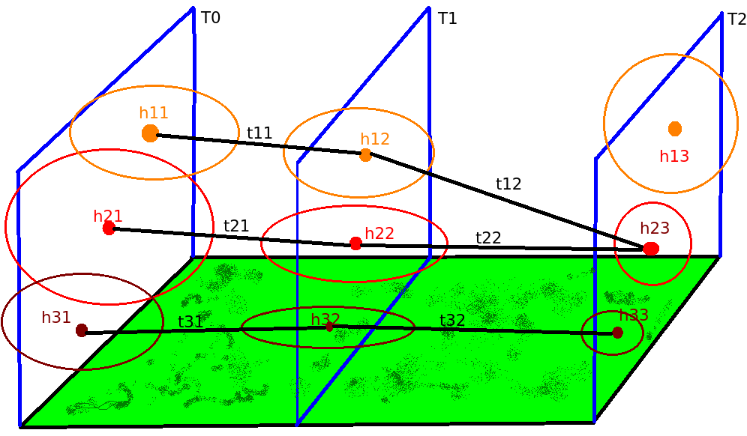
UAV Positioning
The UAV position uncertainty is modeled by a 3D gaussian (h_{ij}) at each sample time (T_{j}), whose parameters are based on sensor analysis. The motion of the UAV is modeled as trajectories (t_{kj}). UAV positioning is formulated as a multi-hypothesis tracking problem.
As the UAV moves, candidate trajectories are pruned based on trends in sensor data at temporal samples leading to gradually higher probabilistic confidence in UAV position.

Slide 41
Summary

Slide 42
Omni-functional UAV Geo-Navigation
All Weather Navigation
Multi-modal sensor video fusion (EO, IR, NV, LiDAR)
3D geometry aided alignment of sensor images
Vision aided Inertial Navigation
Kalman Filter framework for IMU based navigation
Vision based correction for ego-motion parameters of UAV
GIS (global) + UAV (relative) navigation
Spatial-contextual descriptor for GIS map and UAV ground plane features
Markov model for UAV trajectory matching and geo-localization

Slide 43
Vision Aided Inertial Navigation
UAV video analysis: detection of key-points and features on images of ground
Estimation of altitude and motion from analysis of detected keypoint across frames of UAV video using 3D geometry
Kalman Filter framework for inertial navigation
Estimations from vision component used to correct for drift in inertial navigation
Applicable in GPS-degraded or sparse-GPS environments

Slide 44
Multi-modal Analysis
Independent or combined use of different vision sensors Electro-Optic, Infra-Red, Night-Vision
Image Registration for combining video from different sensors for day/night and adverse weather operation
LiDAR sensor (if available) aids accuracy of video frame alignment of 2D ground plane from UAV.

Slide 45
GIS + UAV
UAV video analysis provides sparse image features and estimates position of these features on 2D ground plane
Spatial-contextual information based descriptor, like shape context uses a log-polar accumulator to encode 360 degree neighborhood
Hidden Markov Model for trajectory state as UAV moves and similar HMM for 'hypothesis' trajectories in GIS sourced map.
Quantization by shape-context and scaling number of feature points can improve matching score of sparse UAV with GIS.

